Slide 1
 |  |  |  | Chapter 2
 |  |  | Simulation Examples
Banks, Carson, Nelson & Nicol Discrete-Event System Simulation

Slide 2
Simulation steps using Simulation Table
Determine the characteristics of each of the inputs to the simulation (probability distributions).
Construct a simulation table (repetition 1).
For each repetition i, generate a value for the inputs, and evaluate function, calculating a value of response y_{i}.
٢

Slide 3
The simulation table provides a systematic method for tracking system state over time.
Inputs
Response
Repetitions
X_{i1}
X_{i2}
…
X_{ij}
…
X_{ip}
y_{i}
1
2
·
·
·
n

Slide 4
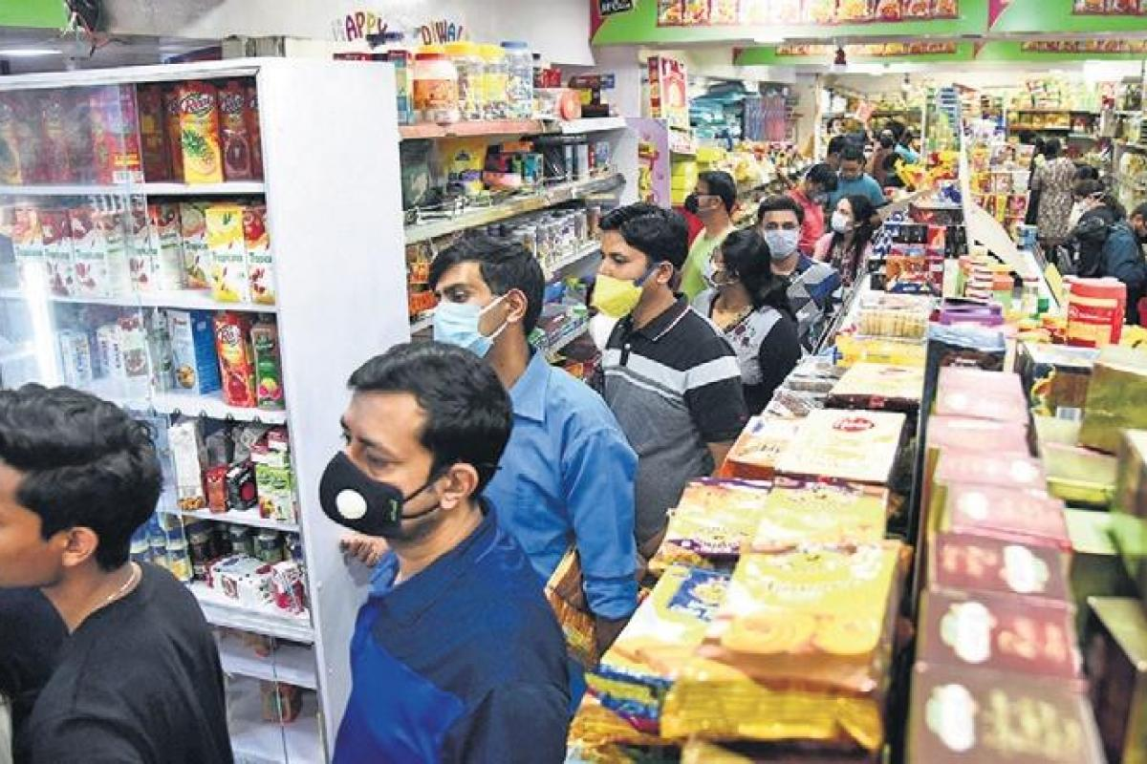
Simulation of Queueing Systems: Why?

Slide 5
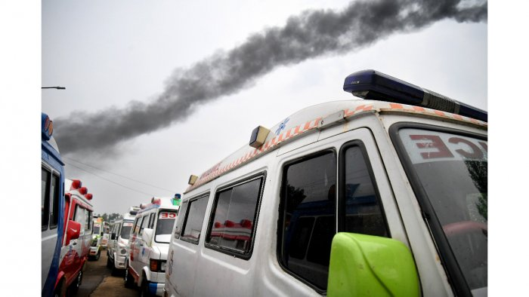
Ambulances queued up with Covid-19 dead bodies for crimination

Slide 6
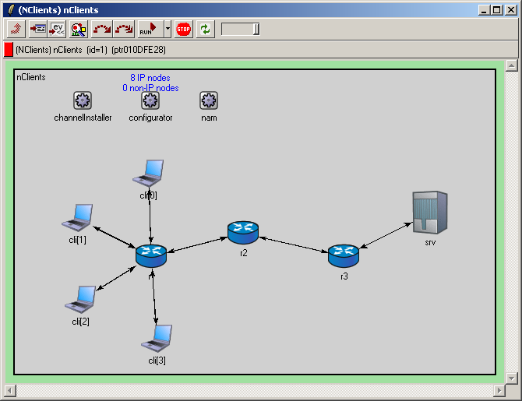
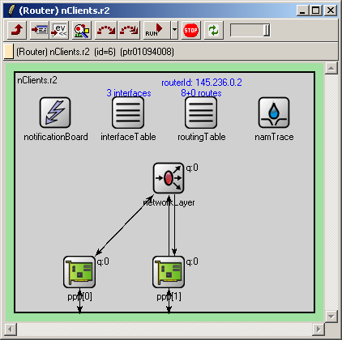
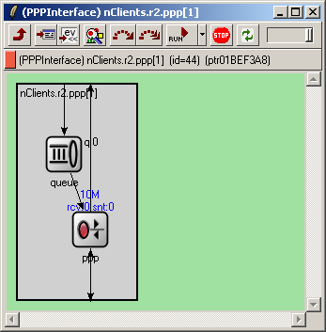
Simulation of Queueing Systems: Why?

Slide 7
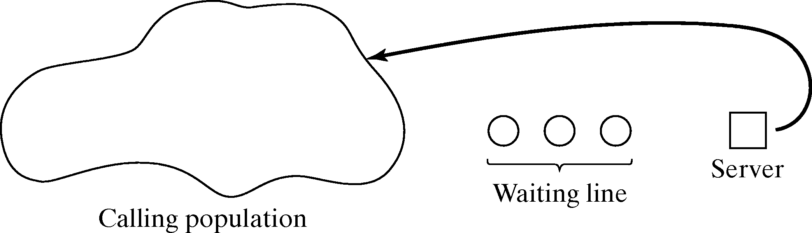
Simulation of Queueing Systems
A queueing system is described by
Calling population
Arrival rate
Service mechanism
System capacity
Queueing discipline

Slide 8


Simulation of Queueing Systems
Single server queue
Calling population is infinite
Arrival rate does not change
Units are served according FIFO
Arrivals are defined by the distribution of the time between arrivals  inter-arrival time
Service times are according to a distribution
Arrival rate must be less than service rate  stable system
Otherwise waiting line will grow unbounded  unstable system
Queueing system state
System
Server
Units (in queue or being served)
Clock
State of the system
Number of units in the system
Status of server (idle, busy)
Arrival of a Unit
Departure of a Unit
Events
Calling population
^{t}i+1
t_{i}
Arrivals
Server
Waiting line

Slide 9
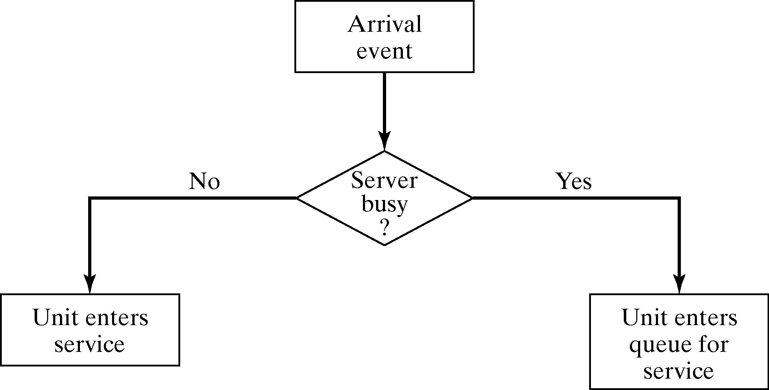
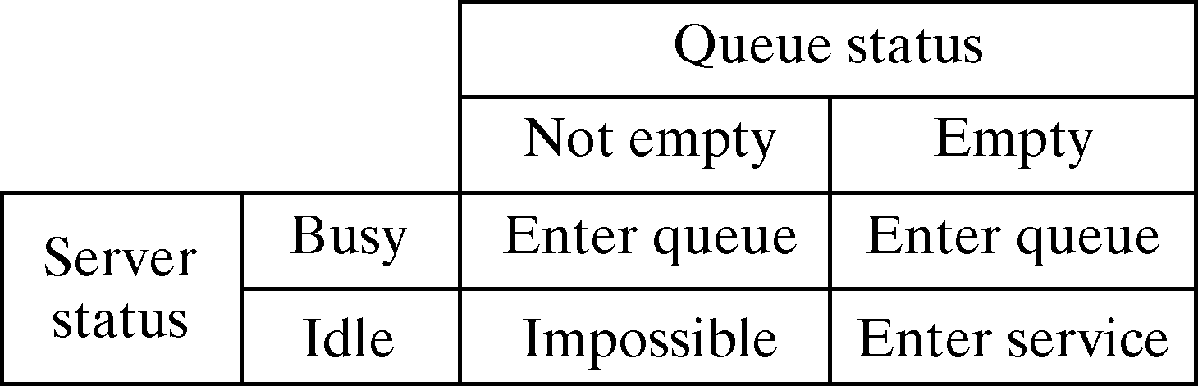
Simulation of Queuing Systems - Arrival Event
If server idle unit gets service, otherwise unit enters queue.
Unit-entering-system flow diagram
How do events occur?
Events occur randomly
Interarrival times ∈ {1,...,6}
Service times ∈ {1,...,4}

Slide 10
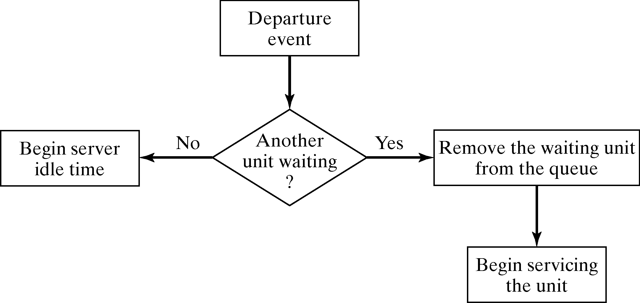
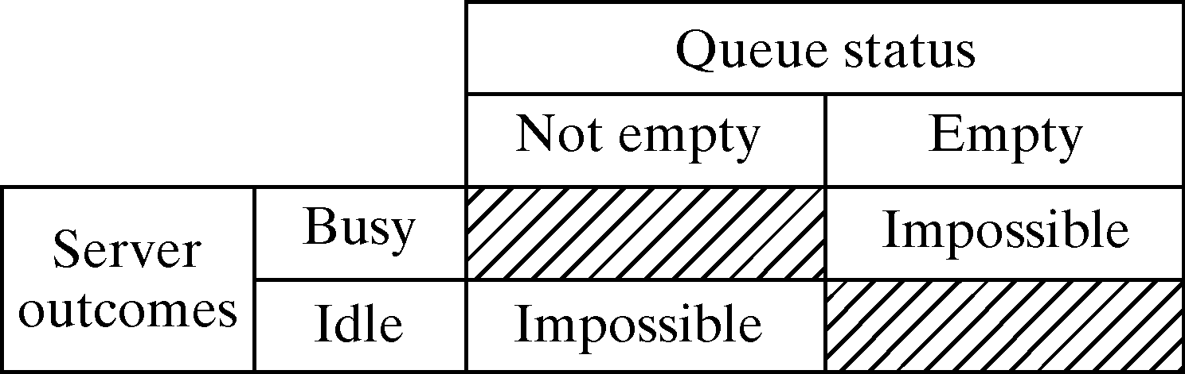
Simulation of Queuing Systems - Departure Event
If queue is not empty begin
servicing next unit, otherwise server will be idle.
Service-just-completed flow diagram

Slide 11

Example : Grocery Center
One checkout counter
Arrival time between customers are 1 to 8 minutes (equal probability)
Service time vary from 1 to 6 (service time table)
We are going to analysis for 100 customers

Slide 12
Example 1: A Grocery
Analysis of a small grocery store
One checkout counter
Customers arrive at
random times from {1,2,…,8} minutes
Service times vary from {1,2,…,6} minutes
Consider the system for 100 customers
Problems/Simplifications
Sample size is too small to be able to draw reliable conclusions
Initial condition is not considered
Interarrival Time [minute] | Probability | Cumulative Probability
1 | 0.125 | 0.125
2 | 0.125 | 0.250
3 | 0.125 | 0.375
4 | 0.125 | 0.500
5 | 0.125 | 0.625
6 | 0.125 | 0.750
7 | 0.125 | 0.875
8 | 0.125 | 1.000
Service Time [minute] | Probability | Cumulative Probability
1 | 0.10 | 0.10
2 | 0.20 | 0.30
3 | 0.30 | 0.60
4 | 0.25 | 0.85
5 | 0.10 | 0.95
6 | 0.05 | 1.00

Slide 13
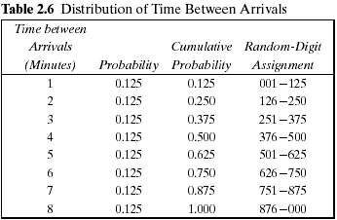
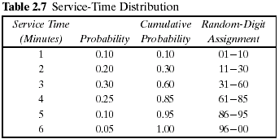
Simulation of Queuing Systems

Slide 14
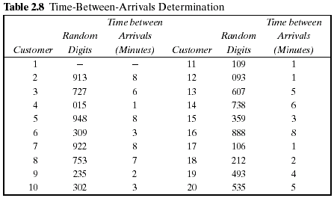
Simulation of Queuing Systems
Example (Cont.) Table 2.8
The first random digits are 913. To obtain the corresponding time between arrivals, enter the fourth column of Table 2.6 and read 8 minutes from the first column of the table.

Slide 15
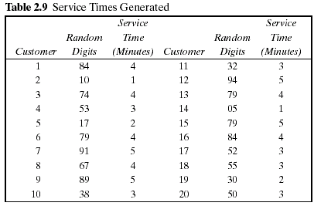
Simulation of Queuing Systems
Example (Cont.) Table 2.9
The first customer's service time is 4 minutes because the random digits 84 fall in the bracket 61-85

Slide 16
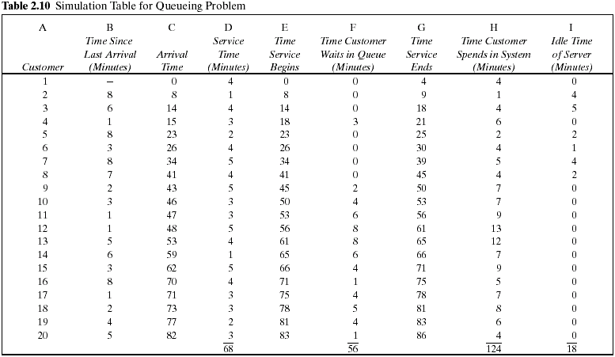

Slide 17
Simulation of Queuing Systems
Example (Cont.)
The average waiting time for a customer : 2.8 minutes
The probability that a customer has to wait in the queue : 0.65
The fraction of idle time of the server : 0.21
The probability of the server being busy: 0.79 (=1-0.21)

Slide 18
Simulation of Queuing Systems
Example (Cont.)
The average service time : 3.4 minutes
This result can be compared with the expected service time by finding the mean of the service-time distribution using the equation in table 2.7.
The expected service time is slightly lower than the average service time in the simulation. The longer the simulation, the closer the average will be to

Slide 19
Simulation of Queuing Systems
Example (Cont.)
The average time between arrivals : 4.3 minutes
This result can be compared to the expected time between arrivals by finding the mean of the discrete uniform distribution whose endpoints are a=1 and b=8.
The longer the simulation, the closer the average will be to
The average waiting time of those who wait : 4.3 minutes

Slide 20
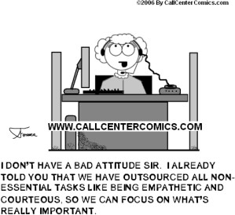
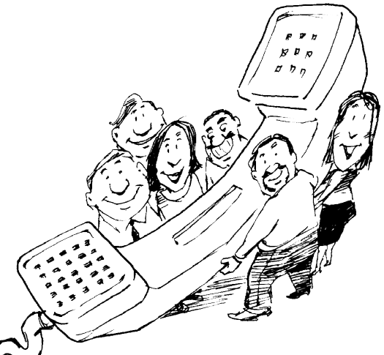
Simulation of Queuing Systems – Able Baker Problem
Example The Able Baker Call Center Problem
A Call Center has 2 employees Able and Baker who will pick the calls and serve.
Assumptions
Calls arrive in the manner shown in Table 2.11.
Among Able and Baker - Able is better able to do the job and works a bit faster than Baker.
The distribution of their service times is shown in Tables 2.12 and 2.13.

Slide 21
Example 2: Call Center Problem
Consider a Call Center where technical personnel take calls and provide service
Two technical support people (2 server) exists
Able
Baker
more experienced, provides service faster
newbie, provides service slower
Rule
Able gets call if both people are idle
Try other rules
Baker gets call if both are idle
Call is assigned randomly to Able and Baker
Goal of study: Find out how well the current rule works

Slide 22
Simulation of Queuing Systems Example 2 contd..
Example (Cont.)
A simplifying rule is that Able gets the call if both employees are idle.
If both are busy, the call begins service with the first server to become free.
To estimate the system measures of performance, a simulation of 1 hour of operation is made.

Slide 23
Example 2: Call Center Problem
Interarrival distribution of calls for technical support
Time between Arrivals [Minute] | Probability | Cumulative Probability | Random-Digit Assignment
1 | 0.25 | 0.25 | 01 – 25
2 | 0.40 | 0.65 | 26 – 65
3 | 0.20 | 0.85 | 66 – 85
4 | 0.15 | 1.00 | 86 – 00
Service time distribution of Able
Service time distribution of Baker
Service Time [Minute] | Probability | Cumulative Probability | Random-Digit Assignment
2 | 0.30 | 0.30 | 01 – 30
3 | 0.28 | 0.58 | 31 – 58
4 | 0.25 | 0.83 | 59 – 83
5 | 0.17 | 1.00 | 84 – 00
Service Time [Minute] | Probability | Cumulative Probability | Random-Digit Assignment
3 | 0.35 | 0.35 | 01 – 35
4 | 0.25 | 0.60 | 36 – 60
5 | 0.20 | 0.80 | 61 – 80
6 | 0.20 | 1.00 | 81 – 00

Slide 24
Arrival Time generation based on Inter arrival Time
Caller Number. | Random Digit Assignment (RDA for arrival) | Inter arrival Time (IAT) | Arrival Time
1 | - | - | 0
2 | 26 | 2 | 2
3 | 98 | 4 | 6
4 | 90 | 4 | 10
5 | 26 | 2 | 12
6 | 42 | 2 | 14
7 | 74 | 3 | 17
8 | 80 | 3 | 30
9 | 68 | 3 | 33
10 | 22 | 1 | 34

Slide 25
Caller Number. | Random Digit Assignment (RDA for Service | Service time
1 | 95
2 | 21
3 | 51
4 | 92
5 | 89
6 | 38
7 | 13
8 | 61
9 | 50
10 | 49

Slide 26
Example 2: Call Center Problem
Simulation run for 10 calls
Caller Nr. | Interarrival Time | Arrival Time | When Able Avail. | When Baker Avail. | Server Chosen | RDA for Service time | Service Time | Time Service Begins | Able‘s Service Compl. Time | Baker‘s Service Compl. Time | Caller Delay | Time in System
1 | - | 0 | 0 | 0 | Able | 95 | 5 | 0 | 5 |  | 0 | 5
2 | 2 | 2 | 5 | 0 | Baker | 21 | 3 | 2 |  | 5 | 0 | 3
3 | 4 | 6
4 | 4 | 10
5 | 2 | 12
6 | 2 | 14
7 | 3 | 17
8 | 3 | 20
…9 | 3 | 23
10 | 1 | 24
Total

Slide 27
Example 2: Call Center Problem
Simulation run for 10 calls
Caller Nr. | Interarrival Time | Arrival Time | When Able Avail. | When Baker Avail. | Server Chosen | RDA for Service time | Service Time | Time Service Begins | Able‘s Service Compl. Time | Baker‘s Service Compl. Time | Caller Delay | Time in System
1 | - | 0 | 0 | 0 | Able | 95 | 5 | 0 | 5 |  | 0 | 5
2 | 2 | 2 | 5 | 0 | Baker | 21 | 3 | 2 |  | 5 | 0 | 3
3 | 4 | 6 | 5 | 5 | Able | 51 | 3 | 6 | 9 |  | 0 | 3
4 | 4 | 10 | 9 | 5 | Able | 92 | 5 | 10 | 15 |  | 0 | 5
5 | 2 | 12 | 15 | 5 | Baker | 89 | 6 | 12 |  | 18 | 0 | 6
6 | 2 | 14 | 15 | 18 | Able | 38 | 3 | 15 | 18 |  | 1 | 4
7 | 3 | 17 | 18 | 18 | Able | 13 | 2 | 18 | 20 |  | 1 | 3
8 | 3 | 20 | 20 | 18 | Able | 61 | 4 | 20 | 24 |  | 0 | 4
…9 | 3 | 23 | 24 | 18 | Baker | 50 | 4 | 23 |  | 27 | 0 | 4
10 | 1 | 24 | 24 | 27 | Able | 49 | 3 | 24 | 27 |  | 0 | 3
Total

Slide 29
Example 2: Call Center Problem
Simulation proceeds as follows
Step 1:
For Caller k, generate an interarrival time A_{k}. Add it to the previous arrival time T_{k-1} to get arrival time of Caller k as T_{k} = T_{k-1} + A_{k}
Step 2:
If Able is idle, Caller k begins service with Able at the current time T_{now}
Able‘s service completion time T_{fin,A} is given by T_{fin,A} = T_{now} + T_{svc,A} where T_{svc,A} is the service time generated from Able‘s service time distribution. Caller k’s waiting time is T_{wait} = 0.
Caller k‘s time in system, T_{sys}, is given by T_{sys} = T_{fin,A} – T_{k}
If Able is busy and Baker is idle, Caller begins with Baker. The remainder is in analogous.
Step 3:
If Able and Baker are both busy, then calculate the time at which the first one becomes available, as follows: T_{beg} = min(T_{fin,A}, T_{fin,B})
Caller k begins service at T_{beg}. When service for Caller k begins, set T_{now} =
^{T}beg.
Compute T_{fin,A} or T_{fin,B} as in Step 2.
Caller k’s time in system is T_{sys} = T_{fin,A} – T_{k} or T_{sys} = T_{fin,B} - T_{k}

Slide 30
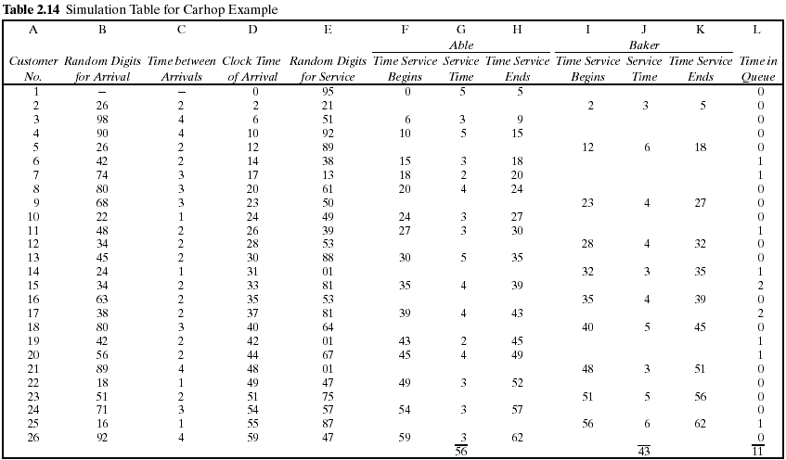

Slide 31
Simulation of Queueing Systems
Example 2.2 (cont.)
The row for the first customer is filled in manually, with the random-number function RAND() in case of Excel or another random function replacing the random digits.
After the first customer, the cells for the other customers must be based on logic and formulas. For example, the “Clock Time of Arrival” (column D) in the row for the second customer is computed as follows:
D2 = D1 + C2
The logic to computer who gets a given customer can use the Excel macro function IF(), which returns one of two values depending on whether a condition is true or false.
IF( condition, value if true, value if false)

Slide 32
No
No
Yes
Nothing
Is Baker idle?
Is Able idle?
Is it time of arrival?
clock = 0
Yes
Yes
No
Yes
Baker service begin (column I)
number for service time
Generate random digit for
Able service begin (column F)
number for service time
Generate random digit for
Store clock time (column H or K)
Convert random digit to random
Convert random digit to random
(column J)
service (column E)
service (column E)
Is there the service
(column G)
completed?
No
Increment clock

